Slide 1

The 2019 TRICS User Survey and Forthcoming System Developments
Nick Rabbets, Managing Director, TRICS Consortium Limited
Notes:
In this presentation I am going to present the results of the 2019 TRICS User Survey, and go through a few system development ideas that users have given us.

Slide 2
TRICS User Survey & System Developments
User Survey sent out to all TRICS users annually.
This presentation will present the findings of the 2019 User Survey.
Findings are based on a total of 73 responses.
User Assessment of TRICS
Suggested future system developments and research topics discussed.
Notes:
The TRICS User Survey is sent out to all member organisations annually. This year the survey was sent out in March, giving us plenty of time to assess the results prior to the User Meeting. In total there were 73 responses, and these consisted of a user assessment of TRICS along with ideas for future system development and research.

Slide 3
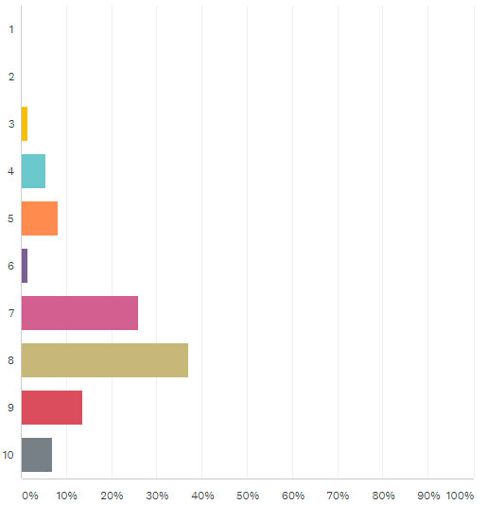
Question 1
“How would you rate the overall usefulness of TRICS and its variety of user options and interactions?”
(1 = very poor, 10 = excellent)
Notes:
Let’s go through a few of the questions of the survey, which focused on how users currently find the TRICS system in terms of its every day use. The first question asked “how would you rate the overall usefulness of TRICS and its variety of user options and interactions?” The results are shown from the top of the graph as 1 for very poor, and at the bottom as 10 meaning excellent. The x-axis shows increments of 10% of responses. So, we can see that the highest scoring number out of 10 is 8, with some 37% of responses. However, we can see that we have room for improvement, which is always what we are trying to do at TRICS.

Slide 4
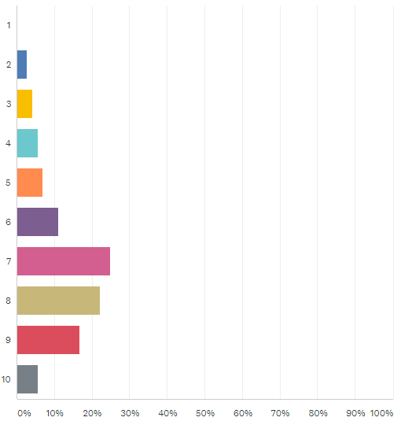
Question 2
“How user friendly and user intuitive do you find the system interface?”
(1 = very awkward, 10 = excellent)
Notes:
Question 2 asked “how user friendly and user intuitive do you find the system interface?” The scores here are quite similar to the previous question, although slightly lower overall, with the highest grouping being 7 out of 10 (around 25% of responses). But there are more responses this year in the 8 to 10 scores.

Slide 5
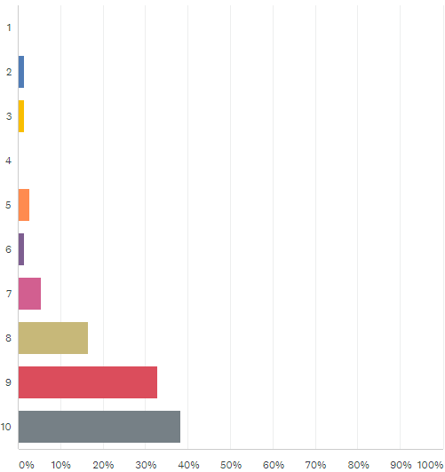
Question 3
“How ‘problem free’ do you find your interactions with TRICS?”
(1 = affected by problems, 10 = no problems)
Notes:
Question 3 asked “How ‘problem free’ do you find your interactions with TRICS?” This is the question that we reworded this year, as there appeared to be confusion in the scoring for previous survey’s. This is great, with the vast majority of people finding no or very few problems. However, there are still a few in the 3 and 4 area, so we will look into this area.

Slide 6
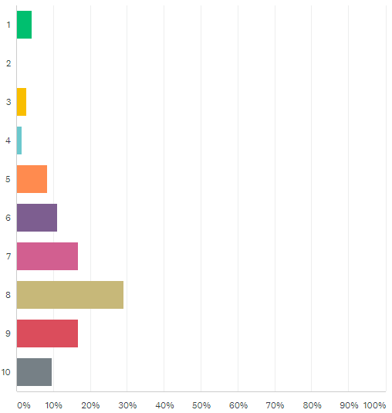
Question 4
“How useful do you find the TRICS Good Practice Guide in understanding the correct use and auditing of TRICS and its data?”
(1 = not useful, 10 = extremely useful)
Notes:
Question 4 now. It asked “how useful do you find the TRICS Good Practice Guide in understanding the correct use and auditing of TRICS and its data?” The Good Practice Guide is very important to us here at TRICS, and we know it is important to the users too. It is good to see that this importance is reflected in the results of this question to a good degree, mostly around the 7 to 9 out of 10 mark, with some variation of course. However, we will be aiming to improve on this result by continuing to listen to users and enhancing and updating the guidance at regular intervals.

Slide 7
Question 5
“Good Practice Guide” Suggestions
‘How to’ Guide for all system functions
Reinforce the importance of providing the full TRICS outputs within reports to ensure full disclosure of analysis
BREEAM (Building Research Establishment Environmental Assessment Method) Guidance
Advice on Sample Sizes etc
Include samples of TRICS analysis and how the various filters etc were used, including possible pitfalls
Notes:
Question 5 asked about suggestions for inclusions within the Good Practice Guide. As you will see by the end of the day the Industry is in a period of change and the Good Practice Guide will be revised to reflect these changes. However, user suggestions also include the following, which we will be including with our next release of the publication.

Slide 8
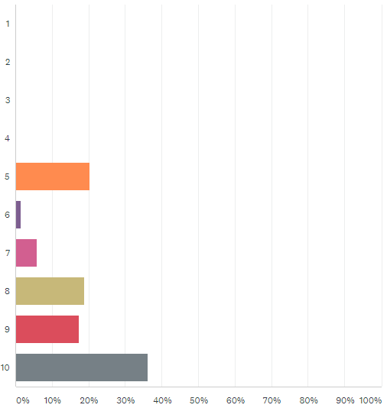
Question 6
“How helpful do you find the TRICS team in responding to your various user/licensing queries?”
(1 = not helpful, 10 = extremely helpful)
Notes:
Question 5 asked “How helpful do you find the TRICS team in responding to your various user/licensing queries?” It seems most people quite happy how we deal with your queries. At TRICS we like to offer the best service to all of our users, and this is much valued feedback from you.

Slide 9
System Developments
System Developments Introduced in the last year or being introduced shortly
Notes:
Moving on from the general questions about TRICS, we can now move into system development specifics. The way in which our system is interactive with its users in its ongoing development is very important to us, as this unique approach has allowed us to evolve the system over 30 years now.

Slide 10
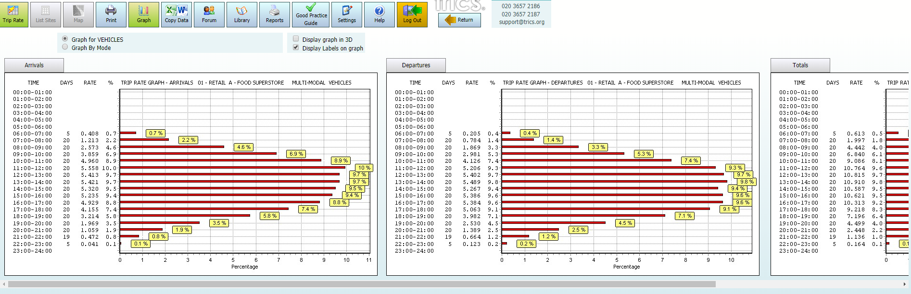
Trip Rate Graphs
All three Trip Rate Graphs now on one page
This development is aimed to reduce the amount of flicking between screens and will assist when comparing Arrivals and Departures.
Notes:
The next improvement is to enable all three trip rate graphs to be shown on a single screen.

Slide 11
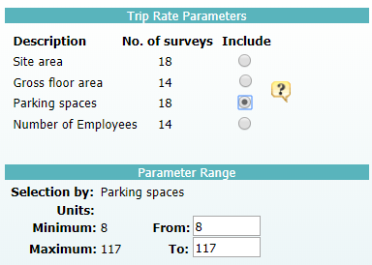
Parking Spaces Trip Rate Parameter
Provide a Parking Spaces Trip Rate Parameter and Range Selection to Primary Filtering
The number of Parking Spaces within a site has now been included as part of the Trip Rate Parameters and Primary Filtering Stage.
Notes:
The next improvement is to provide a Parking Spaces range within the Trip Rate Parameters and Primary Filtering stage. You will now be able to output Trip rates per Car Parking Space and filter sites according to the number of spaces they have on-site. Only sites with this parking information will be able to be selected.

Slide 12
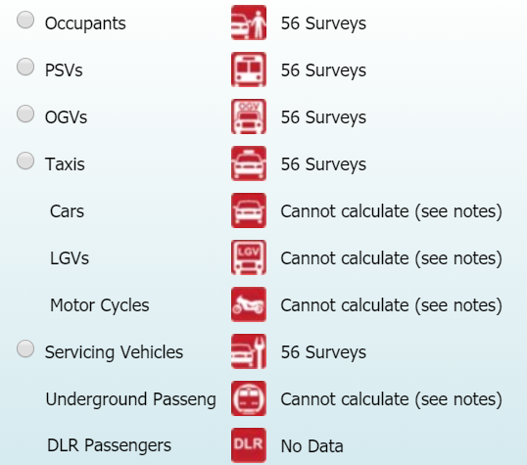
Trip Rate Calculations for Servicing Vehicles
Provide a Trip Rate Calculation Option for Servicing Vehicles
As this mode is now included on more surveys we have introduced the ability to output a trip rate when you select multi-modal surveys.
Notes:
The next improvement is to provide a trip rate calculation option for Servicing Vehicles when you select multi-modal surveys. These surveys have been undertaken for some time now, therefore, it is possible enable this mode to be selected for calculation.

Slide 13
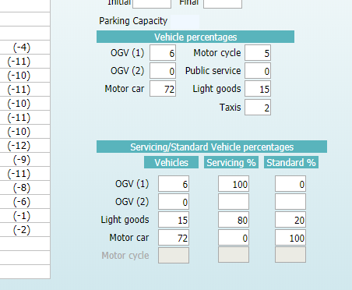
Vehicle Percentages Servicing Vehicles
Provide a Table to show the Percentage split of Servicing Vehicles
New table within the Surveys screen to quickly show percentages of Servicing and Standard Trips.
Notes:
The next improvement is to provide a quick reference table showing the total vehicle count with the percentage of Servicing Vehicles and Standard Vehicles. This will be extremely helpful to see those sites with a high percentage of servicing.

Slide 14
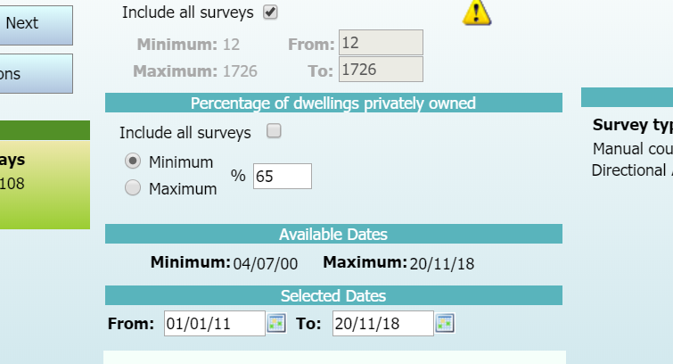
Percentage of Dwellings Privately Owned
Provide an ability to filter residential sites according to their percentage of Privately Owned dwellings
Use of this new section enables the filtering of sites with either a minimum or maximum percentage figure.
Notes:
The next improvement is to provide a filtering option for residential developments. By selecting one of these radio buttons you can filter sites according to their Private/Non-Private make-up.

Slide 15
Number of Seats
Include additional information on Number of Seats for Eating Establishments
06/C (Pub/Restaurant)
06/D (Fast Food – Drive Through)
06/H (Pub/Restaurant + Hotel)
06/I (Public House – Without Restaurant)
This might result in a new Trip Rate Calculation Parameter once there are enough surveys containing this information.
Notes:
The next improvement is to provide additional information of the number of seats within Restaurants. For many Restaurants the GFA of the facility does not give the complete picture with regard to the number of people that can be accommodated at any one time. All surveys within the 2019 programme for these Land-Uses have been collecting this information, once there are enough sites with this information we might introduce a new trip rate calculation parameter so that Trip rates can be calculated by seat.

Slide 16
Motorcycle Class within Servicing Count
Include Motorcycle Deliveries within Servicing Counts
Due to the number of motorcycle couriers within cities and large towns the motorcycle class has now been added to the Servicing Count.
Notes:
The next improvement is to include Motorcycles within Servicing Counts, this will enable the differentiation between visitors to the site and Servicing.

Slide 17
New Land Uses
As well as System Developments we also look at Survey requirements of the System.
Over the past year we have introduced Drive Through Coffee Shops, Assisted Living and Trampoline Parks to our survey programme. Users comments showed that these land uses was starting to emerge. There are no sites yet on the system, but they will be added as soon as they become available.
Notes:
To ensure TRICS keeps up to date we are constantly looking at development trends. These land uses are not a new phenomena, but it has taken quite a time to get sites willing to have surveys done. We have created the land-use categories in the background of the system and will introduce them as soon as the surveys become available. If you have any suggested sites, or have contacts (especially with the coffee drive thru’s) please let us know, as getting permission to undertake surveys is still a big problem for us.

Slide 18
Suggested System Developments
Here are a few System Developments suggested within this year’s User Survey
Notes:
We now move on to some of the ideas suggested by people in this year’s Annual Survey. I hope that the next few slides will enable you to think about suggestions and give feedback. Once we have had our discussions today, we will go away and formulate a programme of system development to take place over the second half of this year

Slide 19
Percentage of Flats
“Allow range selection of Houses opposed to Flats for Residential Categories.”
TRICS Response: This would be something similar to the Private/Non-Private selection facility. .
Notes:
This is something that could be similar to the Private/Non-Private split facility already introduced to the residential categories. We consider this to be an excellent idea and will investigate further. It might only be applicable for certain TRICS Land-use categories and space on the Primary Filtering Screen is starting to become limited. But we will look into the possibility of this.

Slide 20
Filter per Average Bedrooms
“Allow Filtering by the Average Number of Bedrooms within the development.”
TRICS Response: This would be something similar our existing filters and would need some slight amendment to create an average number of bedrooms per development.
Notes:
This is something that could be undertaking with some slight additions to the system.

Slide 21
Car Club Data Field
“Add new data field to identify if a site has a car club (employment/residential land uses).”
TRICS Response: This information can be added to Employment sites easily, as it would just be another piece of information acquired from the site when attaining permission. Could be problematic with Residential sites.

Slide 22
Land Use Selection by Search
“Allow users to search for a land use category by inputting text, as an alternative to the pull-down menus.”
TRICS Response: Great idea. Needs further investigation into how this can be achieved consistently and easily.
Notes:
TRICS already undertakes detailed servicing vehicle counts within Greater London and this may very well be extended to all parts of the UK, if users think it would be of assistance and add value to the system. Once these surveys start to increase it may be necessary to create a more detailed output for Servicing Vehicle data.

Slide 23


Electric Cars
“Identifying how many vehicles are Electric within the surveys.”
TRICS Response: This is something that would be extremely difficult, as there is no real differentiation between the various carbon based and electric models and even hybrid types.

Slide 24
Future TRICS Research Ideas
Notes:
Moving on now from system development to research ideas. Over the years, TRICS has commissioned and undertaken a variety of Research Projects resulting in full Research Papers and Technical Notes. Our User Survey always asks for ideas about potential future projects, and we have picked a few suggestions out to gather further food for thought during todays event.

Slide 25
User Survey Research Ideas Summary
School Travel Behaviour.
Has increase in Home Working and other flexible working arrangements had an impact upon trip rates? Has Peak hour reduced and shoulders changed?
Effects of Travel Plans on multi-occupancy vehicles.
Home Delivery, how has this effected larger vehicle numbers in residential areas? Do Town Centre flat developments generate a high number of deliveries despite their central location?
Notes:
The suggestions from the users were varied and quite interesting. I have taken the many and brought it down to a few that might enable some discussion throughout the day.

Slide 26
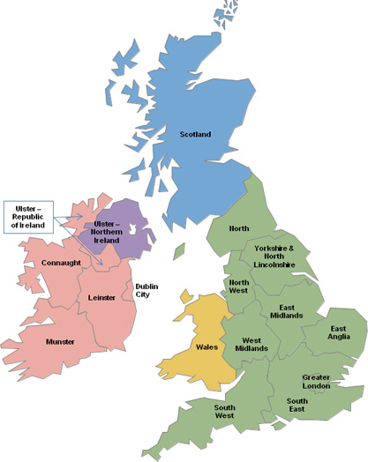
Where would you like to see more TRICS surveys (10 being maximum priority)?
South East 7.9
North 7.6
Yorkshire & N. Lincs 7.6
South West 7.5
East Midlands 7.5
West Midlands 7.4
East Anglia 7.1
North West 7.0
Wales 5.5
Scotland 5.1
Greater London 5.0
Notes:
There were a few other questions at the end of the User Survey that I can just run through with you. We asked users to score the 17 regions of TRICS in order of priority for future surveys (scores out of 10), and the averages are shown here. This year the highest scoring region was South East, with an average of 7.9 out of 10. Some other familiar regions are again ranked highly, with North in second place. We will use this information when preparing our 2020 data collection programme allocations across the regions, so you can be sure that your feedback is definitely used as we move forwards.

Slide 27
Final Question
“Which version of the TRICS system do you use?”
Online Version Only: 100%
Offline Version Only: 0.0%
Both Versions: 0.0%
Notes:
And finally, we asked the users “which version of the TRICS system do you use?”. We regularly ask this question to ensure that we have our users access habits in mind. Over the past few years we have seen the Online Only figure increase and this will help considerably when looking into the development of TRICS 8.

